Slide 1











MealMetrics: Precision Forecasting for Culinary Demand and Supply Optimization
Team 1:
Jiuyuan Xie, Jiayu Yuan,
Jingchen Fu, Victoria Ma
Dec. 6, 2023

Slide 2
Asthma
Allergic reaction affecting the airways in the lungs, leading to difficulty in breathing
In the absence of comorbid illness, the chest radiograph is almost always normal in patients with asthma^{[1]}
Generally, doctors do not use chest X-rays to diagnose asthma
No image dataset available
PASS

Slide 3
Chronic Obstructive Pulmonary Disease (COPD)
(COPD) is a chronic inflammatory lung disease that causes obstructed airflow from the lungs.
Unlike asthma, COPD is not fully reversible and tends to have a more consistent airflow limitation.
Diagnosis: typically spirometry. (air inhalation and exhalation)
Plain chest radiographs have a poor sensitivity for detecting COPD^{[1]}.
Predicting prognosis and exacerbations is more important
However, CXR datasets with prognosis labels are hard to find
PASS
Notes:
As an example, only about half of patients with COPD of moderate severity are identified as having COPD by a plain chest radiograph (ie, sensitivity of 50 percent).

Slide 4
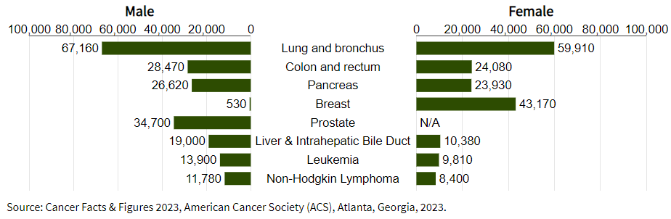
Lung Cancer
Lung and bronchus cancer is responsible for the most deaths
No symptoms on early stage. Often diagnosed at an advanced stage
Diagnosis: typically involves imaging tests such as X-rays and CT scans, followed by a biopsy to examine tissue for cancer cells
Early detection is crucial

Slide 5
Pneumonia
Infection that inflames the air sacs (alveoli) in one or both lungs
A variety of organisms, including bacteria, viruses, and fungi, can cause pneumonia
Diagnosis: infiltrate on chest imaging in a patient with a clinically compatible syndrome ( fever, dyspnea, cough, sputum production)

Slide 6
Respiratory Syncytial Virus (RSV)
Common respiratory virus, for adults, usually causes mild, cold-like symptoms, and limited to upper respiratory tract infections.
Can lead to life-threatening pneumonia in older persons, immunocompromised patients, and those with underlying cardiac or pulmonary disease
Most common cause of lower respiratory tract infection in children <1 year of age, an important cause of death in infants and young children
Radiographic findings are not specific to RSV and may be similar to other respiratory viruses^{[1]}

Slide 7



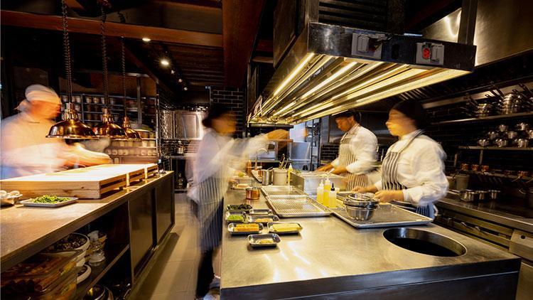

Notes:
Restaurant managers and owners often face problems guessing how many orders they'll get. This uncertainty can lead to having too many or too few staff working at times.
Let's say you want to guess how many orders there are going to be in Pittsburgh tomorrow. If that's the only information you have - a city and a day - you're going to be shooting in the dark. But let's say I told you that yesterday, Pittsburgh placed 200 orders. You'd probably guess there'd be around 200 orders again tomorrow. Or maybe you know that tomorrow is Friday, and you know that people order more on Fridays. Maybe you'd increase your guess to 300. So congratulations, you've just performed your first volume forecast! That's essentially what we do here at our app: use historical order volume,combined with additional predictors, like when and what type of orders are made, the weather, and local events, to create accurate and flexible forecasts for our business.

Slide 8

Use Case
What’s this?
An "Order Forecasting App" specifically designed for restaurants, grocery stores, and meal delivery services.
Purpose:
This app is intended to transform complex data (like order times, types of orders, and external factors such as weather conditions and local events) into clear predictions of order volumes at specific times.
Notes:
What We're Selling & To Whom: We're introducing a time series forecasting app, designed to predict future meal order volumes for restaurants, grocery stores, and meal delivery services. This tool is aimed at small to mid-sized culinary businesses seeking to optimize their inventory and staffing based on accurate demand predictions.
This app is intended to transform complex data (like order times, types of orders, price, target of interest and external factors such as promotional information and homepage featured ) into clear predictions of order volumes at specific times.

Slide 9




Selling Points
Accurate Prediction of Order Volumes
Operational Cost Reduction
Improved Service Quality
Data-Driven Decision Making
Ease of Use and Integration
< BACK TO NAVIGATION PAGE
Notes:
Accurate Staffing Optimization: By predicting order volumes accurately, the tool aids in efficient staff scheduling, reducing the risks of over or understaffing.
Operational Cost Reduction: Enhanced staffing efficiency directly contributes to lowering labor costs and operational expenses.
Improved Service Quality: Accurate forecasting leads to reduced customer wait times and overall improvement in service quality.
Data-Driven Decision Making: The tool enables decision-making based on data analytics, which is more reliable than guesswork or intuition.
Ease of Use and Integration: A user-friendly interface and the ability to integrate seamlessly with existing systems like POS and workforce management software are crucial features.

Slide 10






Jobs to be Done
Target User | decision-makers in the food industry, managers of large distribution center heads of meal delivery services.
User Goals | manage inventory efficiently, particularly perishable goods, optimize staffing levels to meet customer demand without excess expenditure.
< BACK TO NAVIGATION PAGE

Slide 11

Market Insights & Predictive Impact: Key Hypotheses
Hypotheses Underlying the Idea
H1: Food waste and scheduling issues stem from unpredictable order volumes.
H2: Historical data analysis improves order volume prediction accuracy.
H3: A niche tool can offer bespoke solutions for food preparation challenges.
H4: Predictive insights will enhance planning and efficiency, yielding ROI.
H5: Tool adoption relies on user-friendliness and system integration ease.
H6: The tool will respect data privacy laws, ensuring responsible use of historical order data.
H7: Strong security and regulatory compliance will safeguard data, building user trust.
H8: The tool's staff scheduling features will comply with regional labor laws, considering varying predictive scheduling allowances.

Slide 12


Strategic Insights:
Unveiling Our Market Edge
What do we offer? | How Does It Save Money?
Provide precise demand forecasting Tackle the challenges of overstocking, understocking, and inefficient staff scheduling | Lower costs by reduce food waste Optimize labor hours
What Enhances Its Value? | Why our product?
Specificity to the food and meal delivery industry High predictive accuracy | Reliable WEEKLY database USER-FRIENDLY interface regardless of technical expertise Accurate forecasting combining MULTIPLE MODELS (ARIMA, ETS, Random Forest)

Slide 13
Buyer Persona:
Target Audience: Managers/Owners of Urban Restaurants and Distribution Centers, mid-30s to 40s.
Key Challenges: Inventory and demand management, staff scheduling, data analysis constraints.
Goals: Enhance operational efficiency, minimize waste and expenses, elevate customer and client satisfaction.
Product Benefits: Reliable forecasts, actionable insights, seamless system integration, time efficiency.
Engagement Channels: Industry forums, trade shows, targeted digital marketing.
Notes:
The buyer persona for the Order Forecasting Tool is a "Tech-Savvy Restaurant Operations Manager," likely aged between 30-50, working in urban or suburban areas. They are often key decision-makers or influencers in their restaurant or restaurant chain, with a strong background in restaurant management and an understanding of operational challenges. Their primary goals include optimizing staffing, reducing operational costs, and improving customer service quality. They value efficiency, data-driven solutions, and are comfortable with technology. They engage with industry news through platforms like LinkedIn and attend industry events to stay informed.

Slide 14

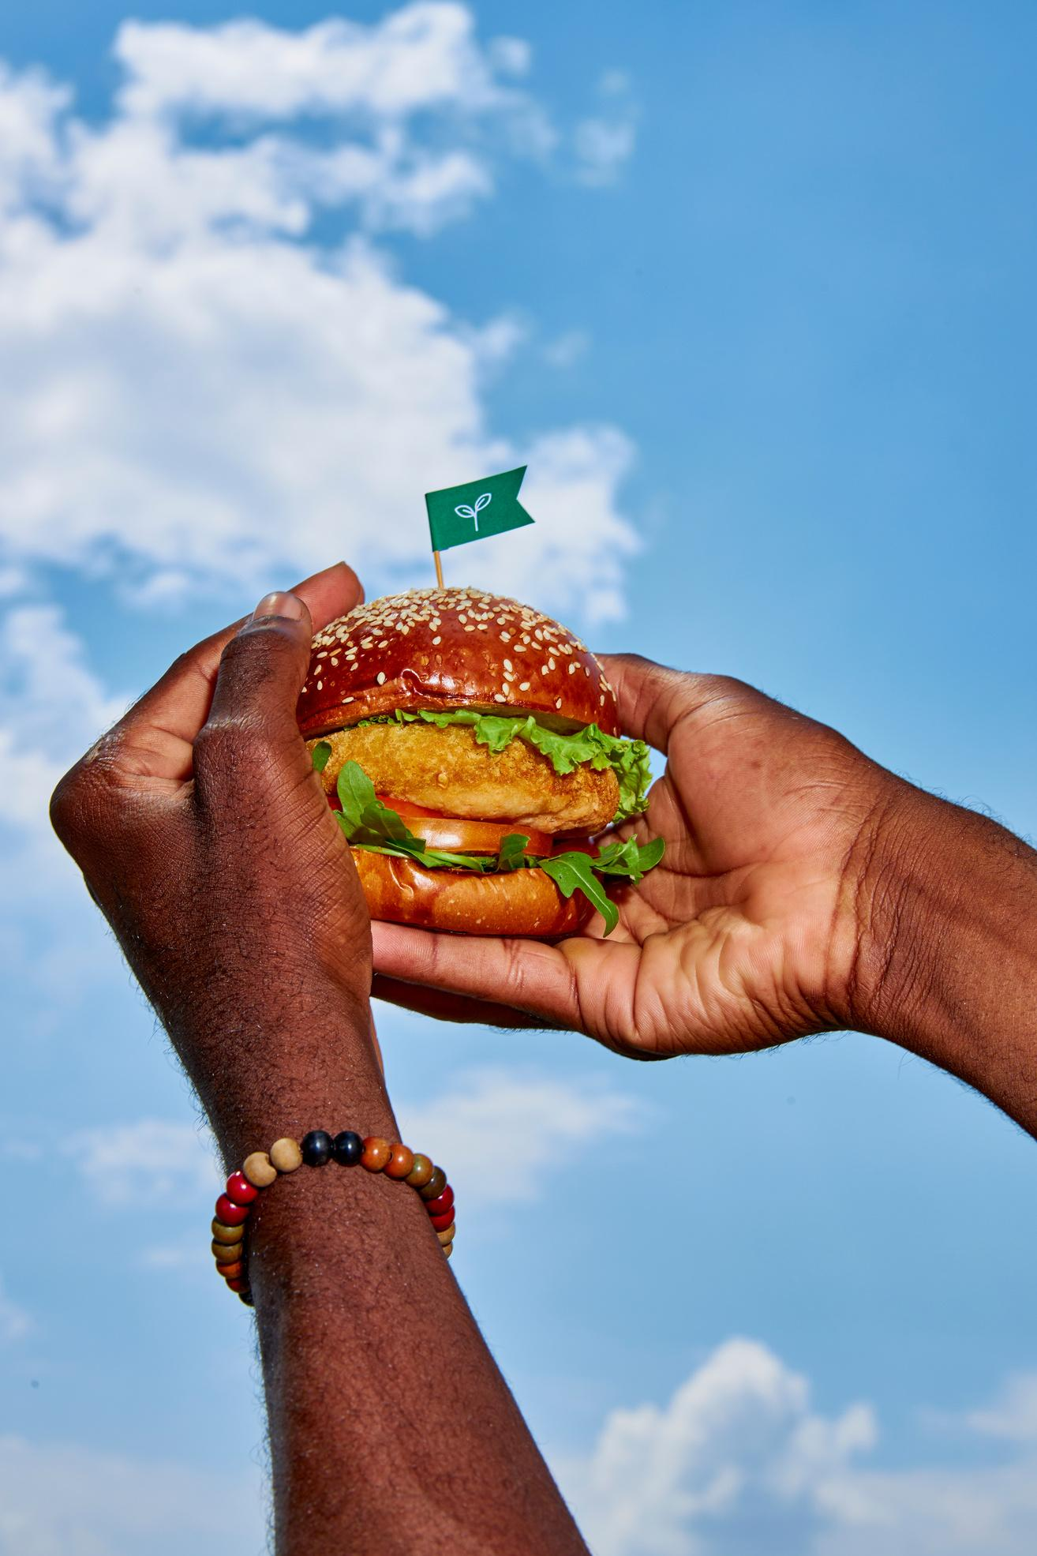
Data Requirements
Historical order data on weekly basis: Identifier of the item (e.g. meal_id) Target of interest (e.g. num_orders) Price (e.g. checkout_price and base_price)
External factors: emailer_for_promotion Homepage_featured …
< BACK TO NAVIGATION PAGE
Notes:
The app requires historical order data on weekly basis, including Meal_id (identify the combination of item categories)num_orders, checkout_price, base_price. external factors like whether have advertising emails for promotion, and whether the homepage is featured. Data from various fulfillment centers across different regions will be pivotal for understanding demand patterns.

Slide 15
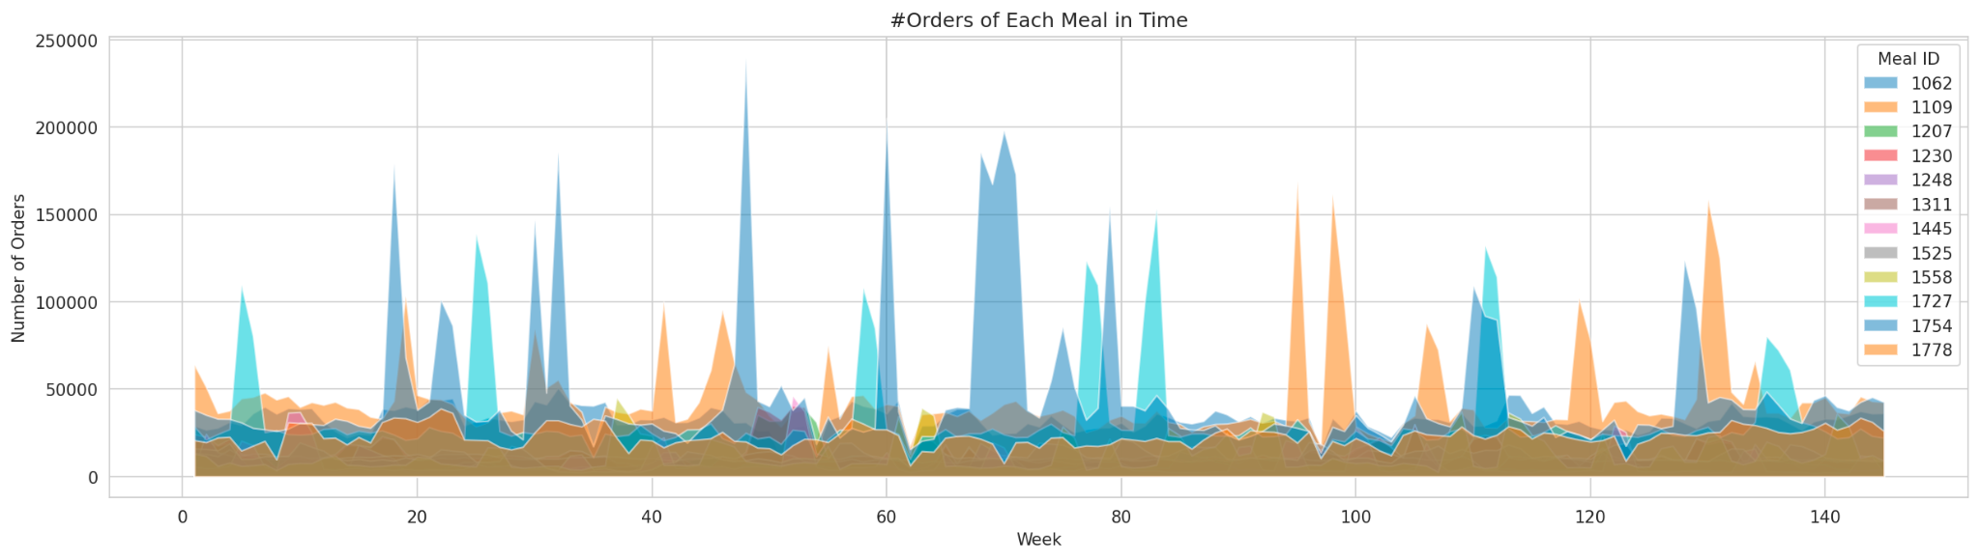
Dataset - Overview
Data Source: kaggle food demand dataset
3yrs+ Time Duration
77 buyers
52 meals
20 Forecasting Weeks
< BACK TO NAVIGATION PAGE
Notes:
Here is our dataset, it’s the kaggle food demand dataset. The time duration is 3 years, 145 weeks in total. There are 77 centers or buyers which buy our meal product. And there are 52 meals products. The graph of demand is on the right. And we want to give accurate forecast of the next 20 weeks. Next page plz

Slide 16
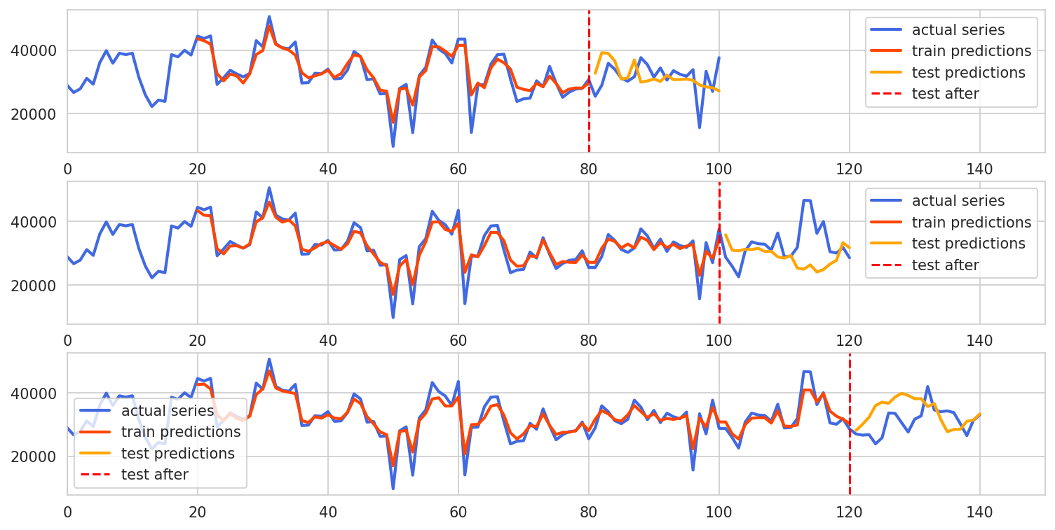
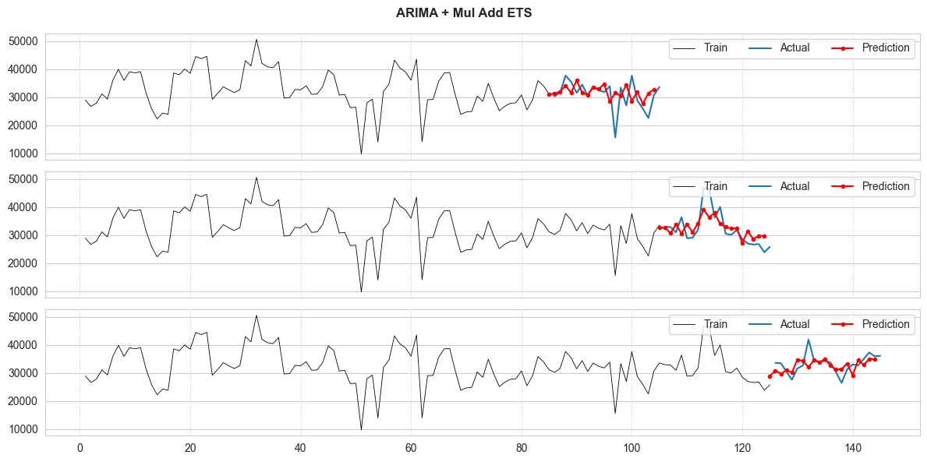
Backtesting - Random Forest
16.25% absolute error cross-validated by 3 periods from week 85
< BACK TO NAVIGATION PAGE
Notes:
We did backtest in three periods, each with 20 weeks forecast, Here is the backtest plot using Random Forest Regressor. The percentage error is about 16. Next page plz

Slide 17
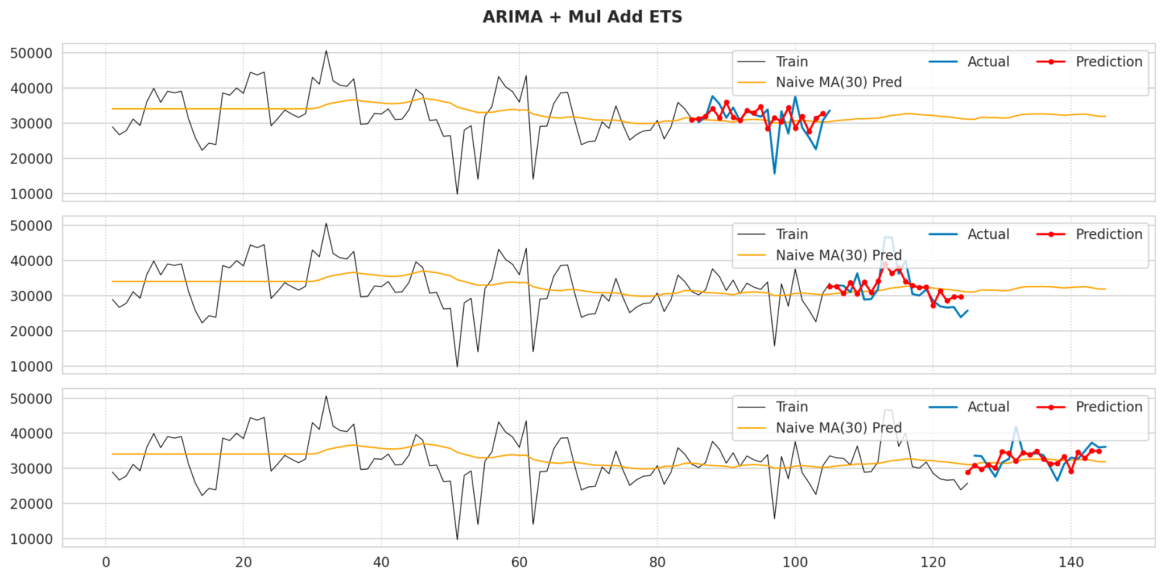
Backtesting - ARIMA + Mul Add ETS
8.80% absolute error cross-validated by 3 periods from week 85
Food waste +
Order shortage cost: $5 each
Saved $100,756.59
Each 20 days
Each Product
< BACK TO NAVIGATION PAGE
Notes:
here is our best model ARIMA plus ETS… The percentage error is about 8.8. And let me show you how much money you can save by using our amazing models! Let’s say, if are the manager of the restaurant, and each food waste or order shortage cost you 5 dollars for each meal. And you currently use a simple moving average to predict how much order to prepare for the future. Our model is going to save 0.1 million dollars for each meal product that you have, for each 20 days period. If you have 77 products, you are going to save 7 million dollars approximately/
Next page plz

Slide 18
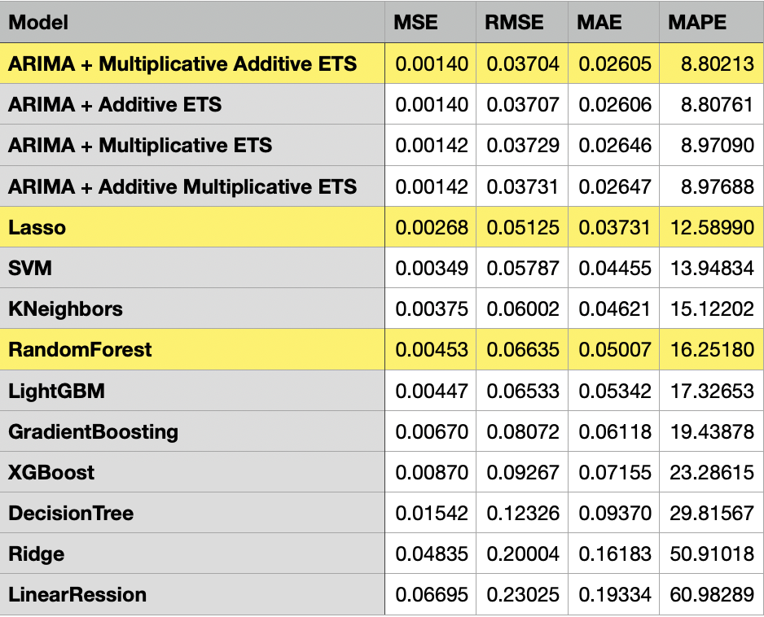
Table of metrics - Backtesting
< BACK TO NAVIGATION PAGE
Notes:
We have 12 models in our products, we've applied ARIMA and ETS forecasting and a combination of both and machine learning models.
ARIMA with Multiplicative Additive ETS perform the best, while for machine learning models, Lasso perform the best.
For our user interface, we've used Random Forest as the default model because of its robustness and excellent performance across diverse data sets, which is crucial for user trust and engagement. However, the platform is designed with flexibility in mind, allowing us to update the underlying model as newer algorithms are developed.
Next page plz

Slide 19
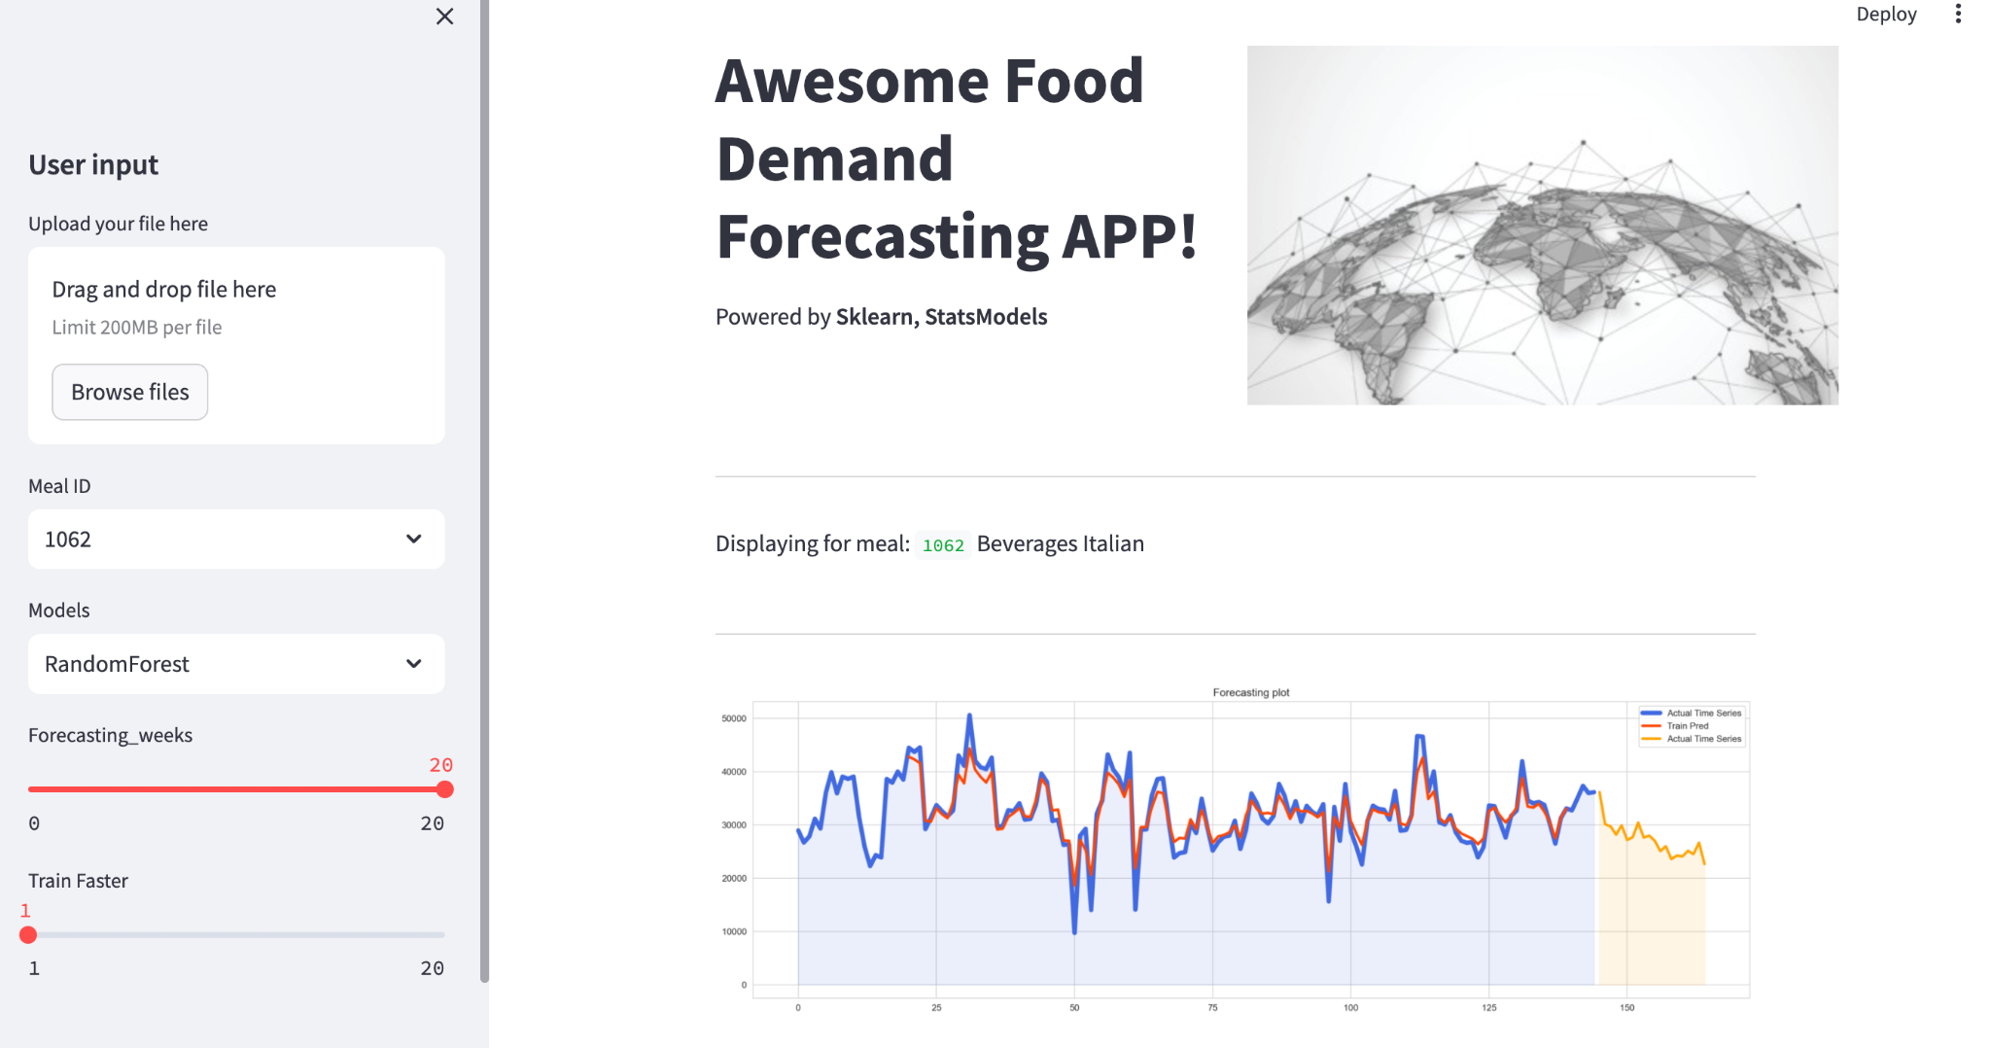
MVP - User Interface
< BACK TO NAVIGATION PAGE
Notes:
This is the UI of our product. It’s made by streamlit. It can take the historical time series of each product, fit a model in real time and create forecast for the next 20 days’. It can greatly help managers and staff to estimate the future demand of each product. And adjust the inventory level and staff scheduling to better prepare for the future. This product is greatly helpful and valuable to meal company or any other kinds of company that involves supply chain. Also we make the Product ID as a user input, we believe that with a simple click, the user without any technological background can easily check any products’ demand forecast in real time, and make strategic plans, and create profit and value for the company. Next page plz

Slide 20






Get In Touch
Email
team1@andrew.cmu.edu
Social Media
@reallygreatapp
Call us
123-456-7890
< BACK TO NAVIGATION PAGE

Slide 21
References:
https://medium.com/analytics-vidhya/multivariate-time-series-restaurant-demand-forecasting-1f1633875bc7
https://www.restaurant365.com/blog/forecasting-for-restaurants-implications-for-inventory-and-labor/
https://www.kaggle.com/datasets/akshatpattiwar/daily-demand-forecasting-orderscsv/data
https://www.kaggle.com/code/nilaydesmukh/restaurant-demand-forecasting/notebook
https://www.kaggle.com/code/pratul007/food-demand-forecasting/notebook#Split-data-into-train-and-validation-sets
https://www.kaggle.com/datasets/kannanaikkal/food-demand-forecasting?select=train.csv
< BACK TO NAVIGATION PAGE

